Slide 1
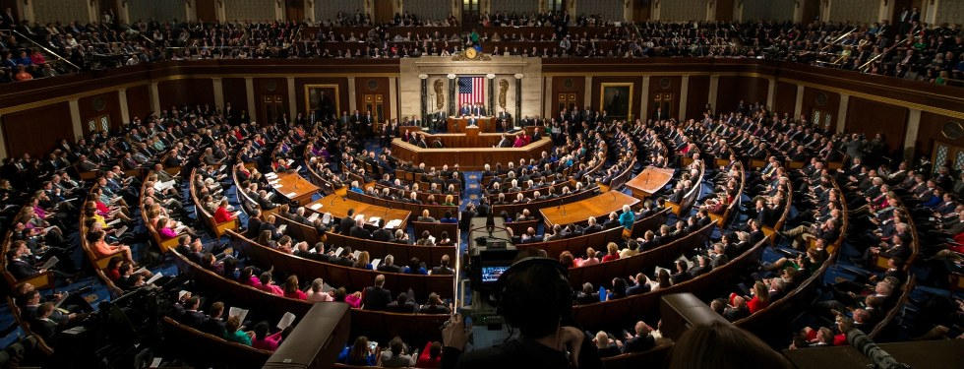
Network and Predictive Analysis on Proposed Legislation in the United States Congress
Spencer Woodfork
Dilpreet Singh
Meena Rapaka

Slide 2
Agenda
Introduction
Data Pre-processing & Databases
Network Analysis
Predictive Modelling
Data Visualization
Conclusion
Data Sources

Slide 3

Introduction
In this project, we perform network analysis of legislators from the past 44 years and try to create a model to predict the legislative outcome of some bill introduced to the US Congress.
http://gov-analytics.net/

Slide 4
Key Questions
1. Can measurable relationships between legislators in United States congress be observed based on co-sponsor support of legislation proposed?
2. What type of communities/cluster are existent based on the co-sponsor support of legislation?
3.How does proposed legislation differ from the communities discovered?
4.Can a predictive model be created using various indicators which can predict the outcome of legislation currently being proposed in congress?

Slide 5
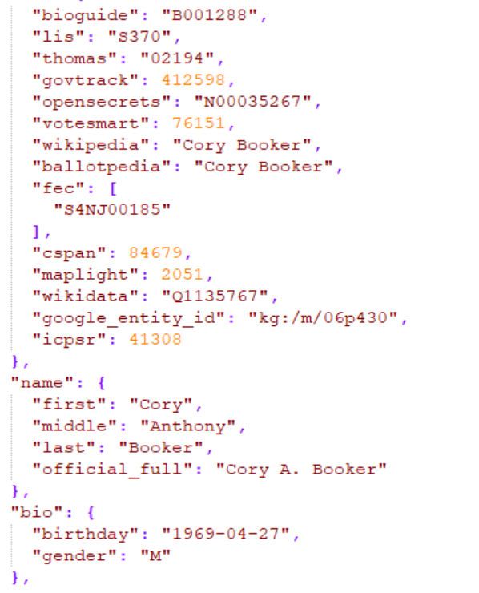
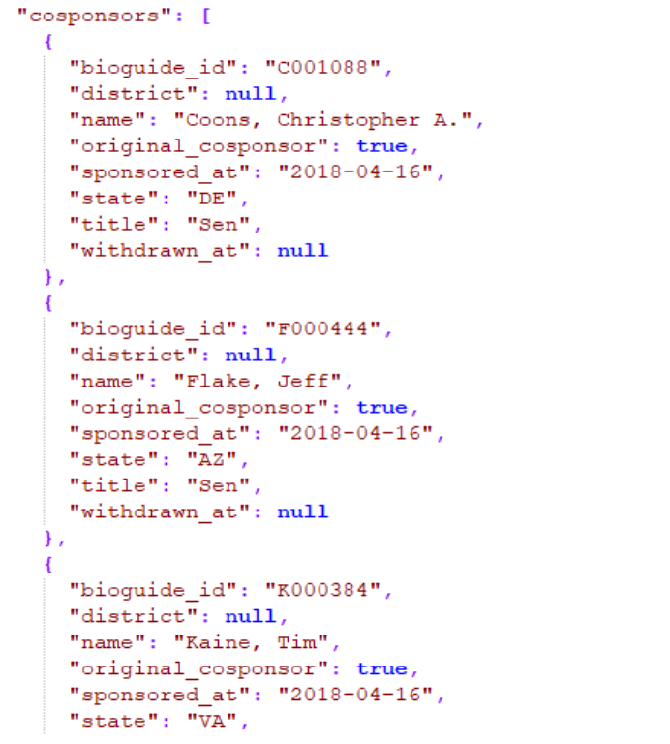
Dataset

Slide 6
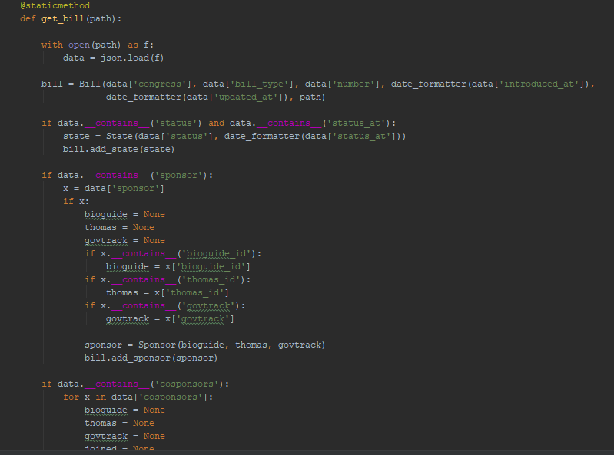
Data Preprocessing

Slide 7
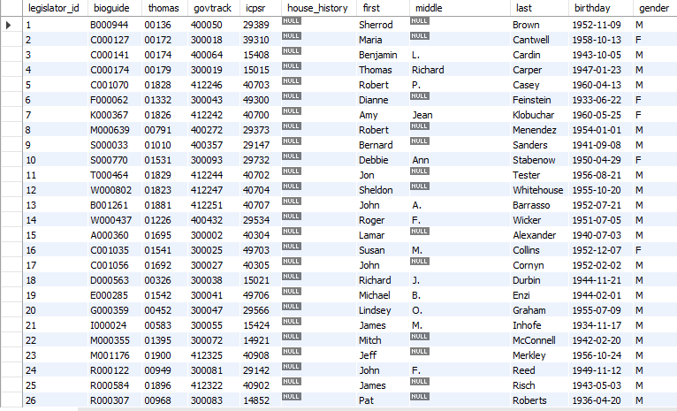
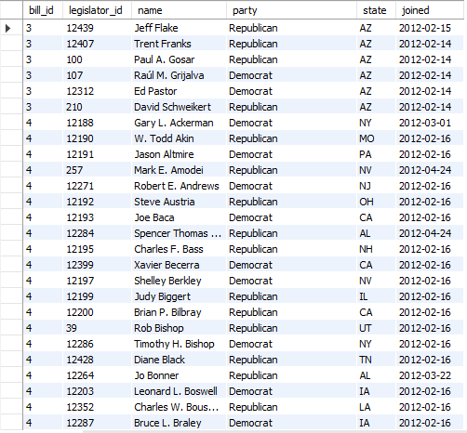
Databases

Slide 8
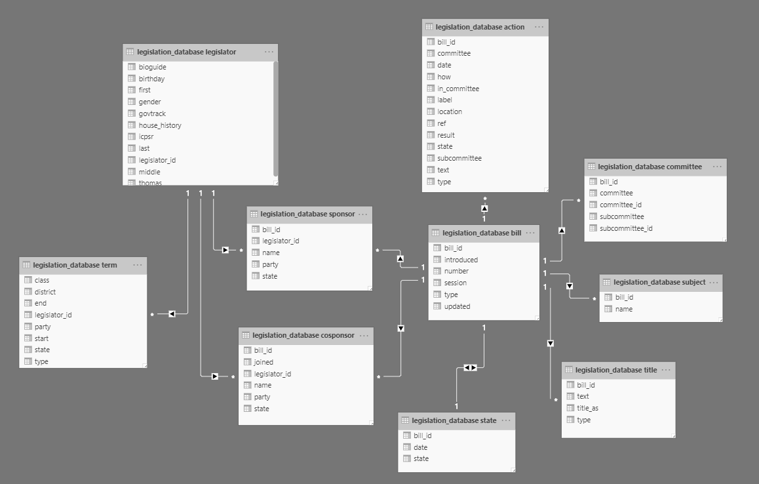
Database

Slide 9
Network Modelling
At least one co-sponsorship equals a relationship
01
At least 10 co-sponsorships equals a relationship
02
At least 20 co-sponsorships equals a relationship
03

Slide 10
Principal Analysis
Network Analysis
Predictive Analysis

Slide 11
Network Analysis
Network Density
Degree Centrality
- In Degree
- Out Degree
Betweenness Centrality
Closeness Centrality
Modularity

Slide 12
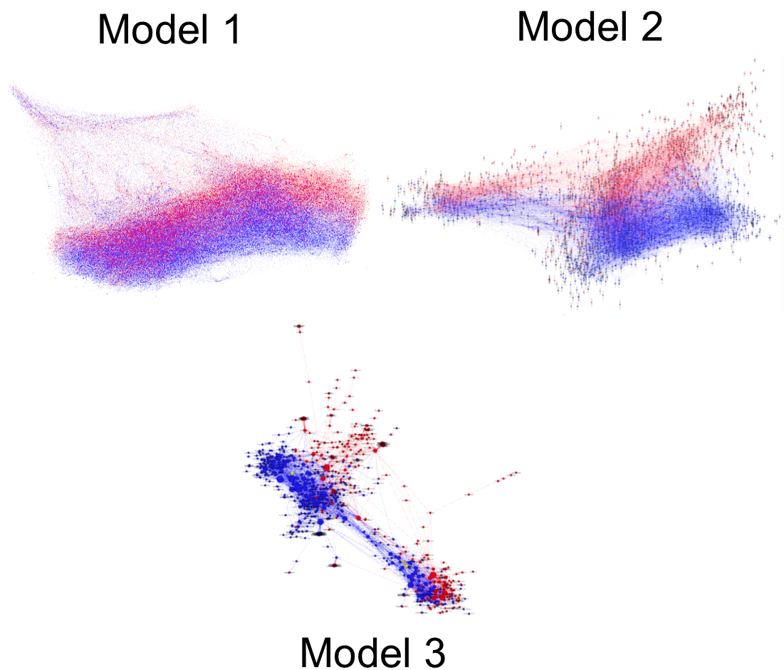
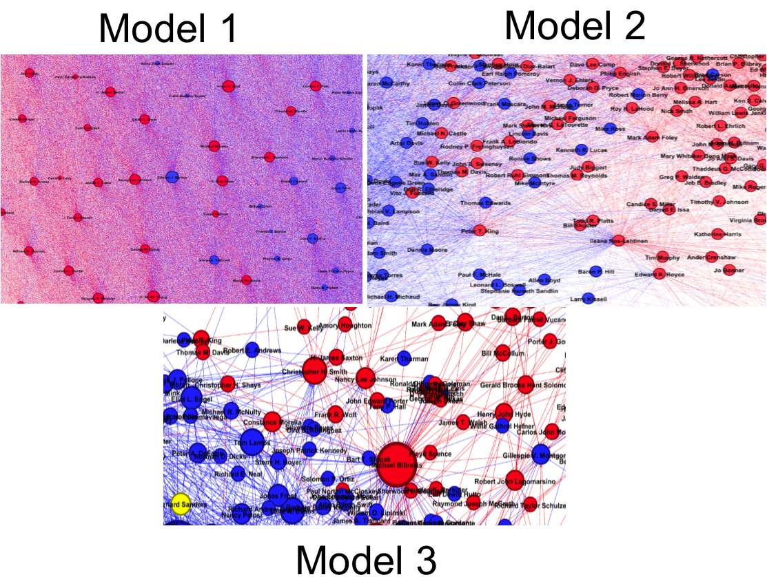
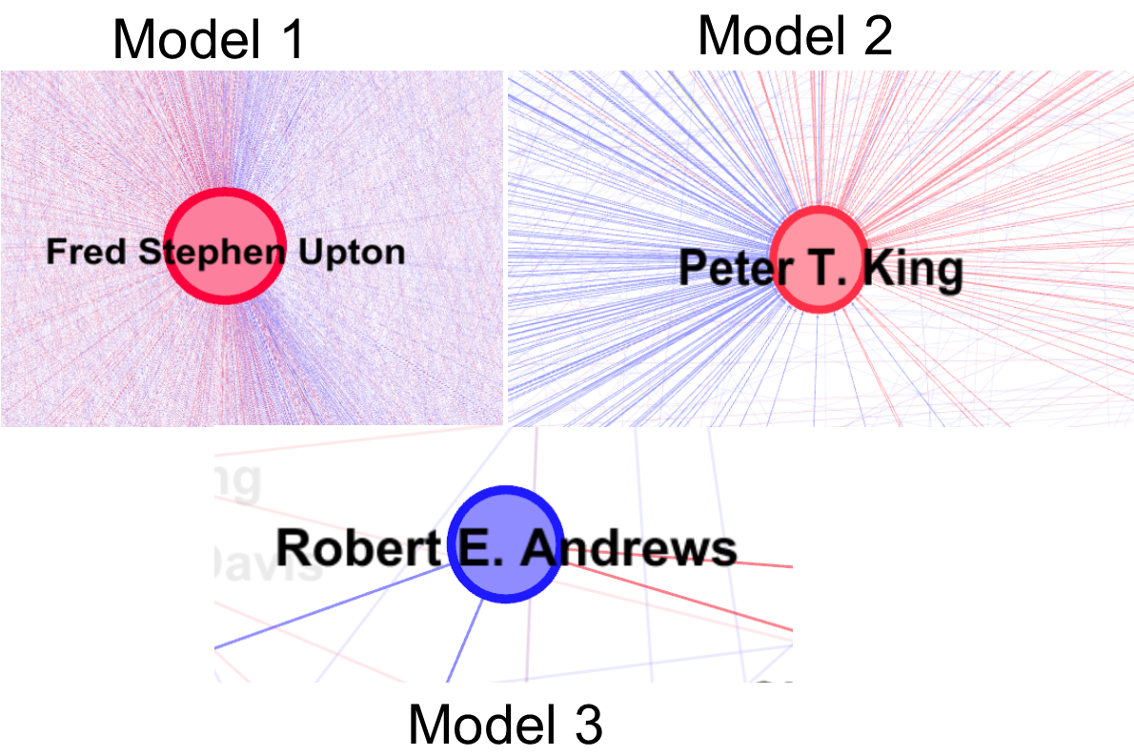
Network Models

Slide 13

Network Density
Network density describes the portion of the potential connections in a network that are actual connections.

Slide 14
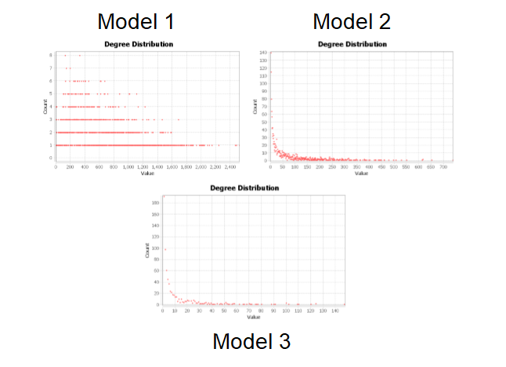
Degree Centrality
Degree centrality of a node refers to the number of edges attached to the node.
In-degree is the number of connections that point inward at a vertex.
Out-degree is the number of connections that originate at a vertex and point outward to other vertices.
Model 1 with an average degree of 306.347, Model 2 had an average degree of 31.802 and model 3 had an average of 5.638.

Slide 15
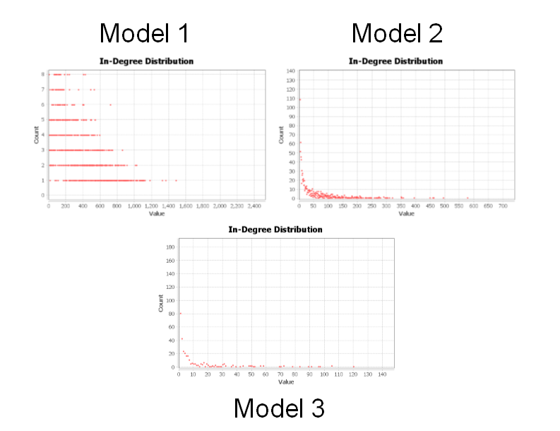
In-Degree
With our models, one cosponsor to another legislator counts towards the in degree of the legislator.

Slide 16
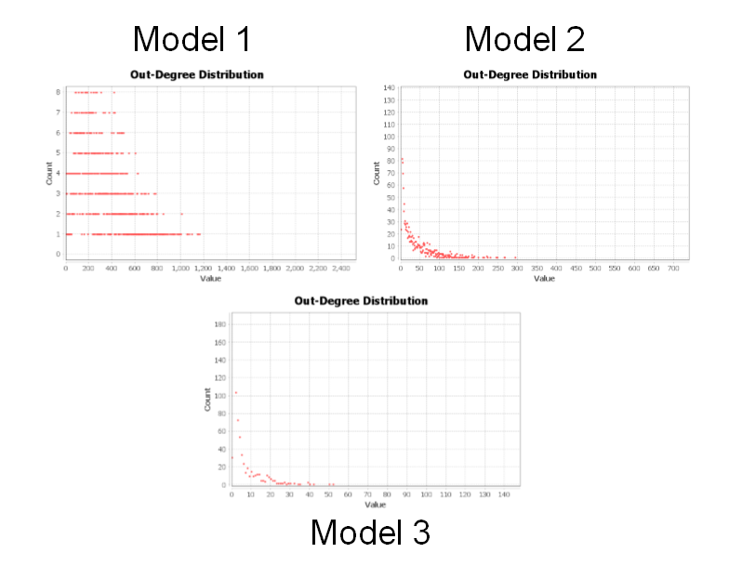
Out-Degree
With our models, one cosponsor to another legislator counts towards the out degree of the co-sponsor

Slide 17
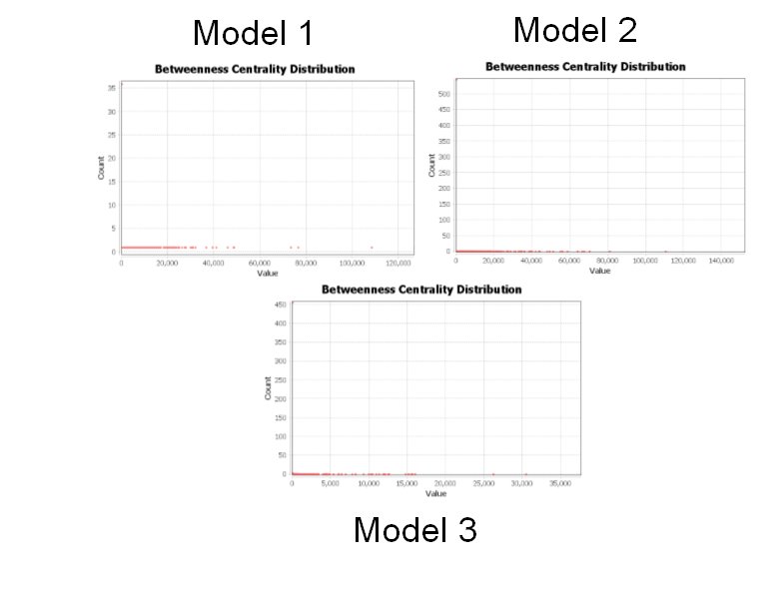
Betweenness Centrality
Is a way of detecting the amount of influence a legislator has over the flow of information.

Slide 18
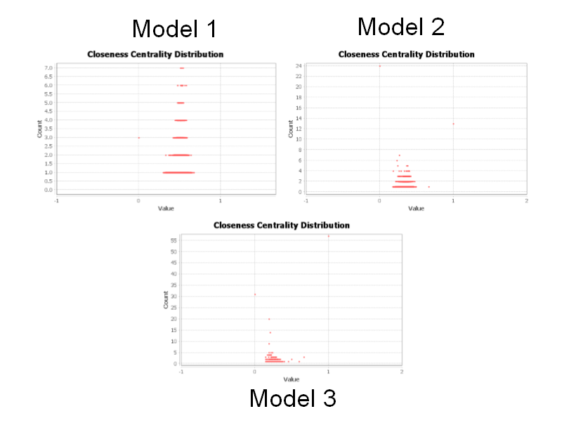
Closeness Centrality
The closeness centrality of a legislator measures its average farness (inverse distance) to all other legislators.

Slide 19
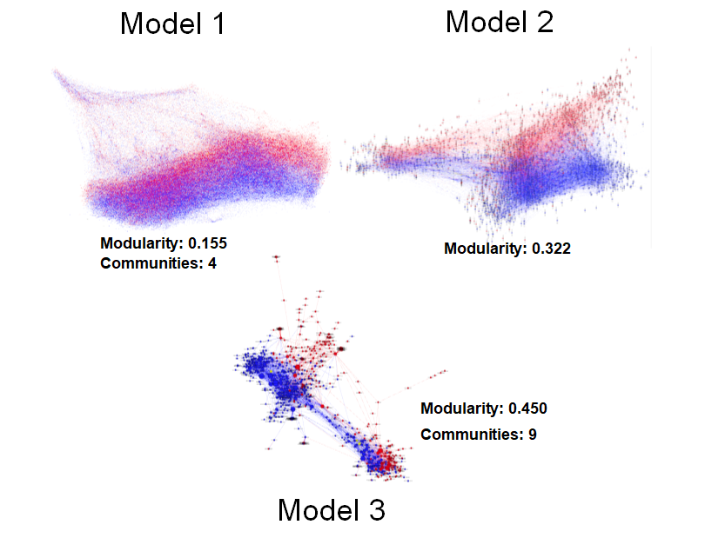
Modularity
Modularity is designed to measure the strength of division in a network

Slide 20
Predictive Analysis
Decision Trees
Predictive Models:
Actions & Partisan Model
Bill Summary Results
Bill Summary & Action Results

Slide 21
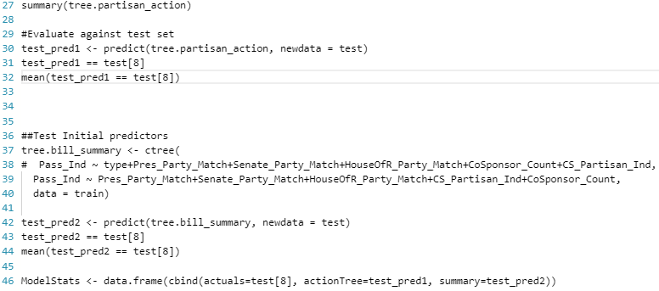
Decision Tree

Slide 22
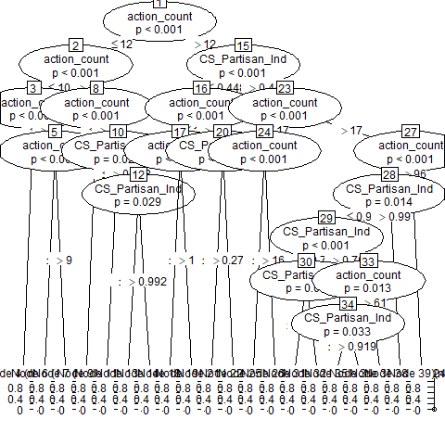
Decision Tree

Slide 23
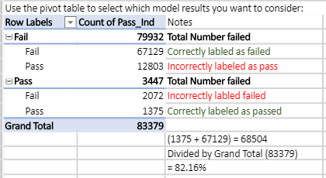
Accuracy of the Bill Summary

Slide 24
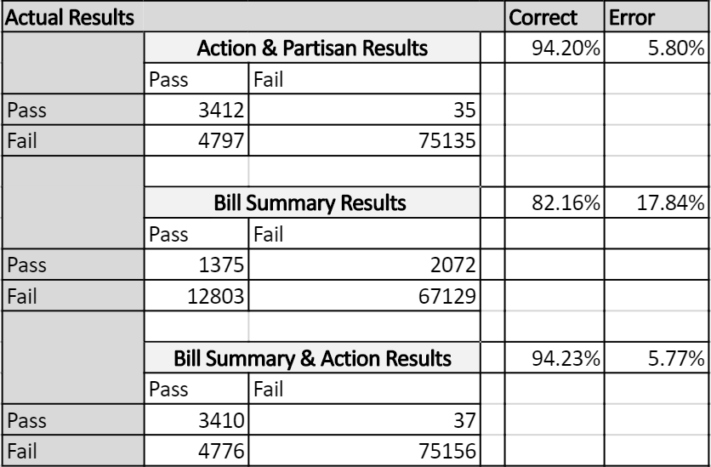
Results of Predictive Models

Slide 25


Slide 26
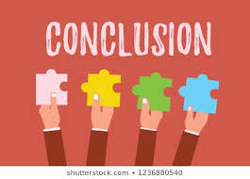

Slide 27

Future Prospects
Term – Weighting
Clustering Coefficient (Enhance the graph to be more dynamic)

Slide 28
